Slide 1
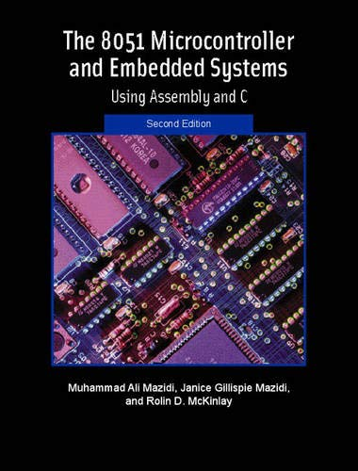
THE 8051
MICROCONTROLLER & Embedded Systems
Muhammad Ali Mazidi, Janice Mazidi
& Rolin McKinlay

Slide 2
8051
ADDRESSING MODES
Chapter 5

Slide 3
Objectives
Upon completion of this chapter, you will be able to:
>> List the five addressing modes of the 8051 microcontroller
>> Contrast and compare the addressing modes
>> Code 8051 Assembly language instructions using each addressing mode
>> Access RAM using various addressing modes
>> List the SFR (special function registers) addresses
>> Discuss how to access the SFR
>> Manipulate the stack using direct addressing mode
>> Code 8051 instructions to manipulate a look-up table
>> Access RAM, I/O, and ports using bit addresses
>> Discuss how to access the extra 128 bytes of RAM space in the 8052

Slide 4
Objectives
Discussing 8051/52 addressing modes in the context of some examples,
Section 5.1, looking at immediate and register addressing modes,
Section 5.2, accessing memory using the direct, register indirect, and indexed addressing modes,
Section 5.3, discussing indexed addressing modes. Section 5.3 discusses the bit-addressability of RAM, registers, and I/O ports,
Section 5.4, showing show how to access the extra 128 bytes of RAM in the 8052.

Slide 5
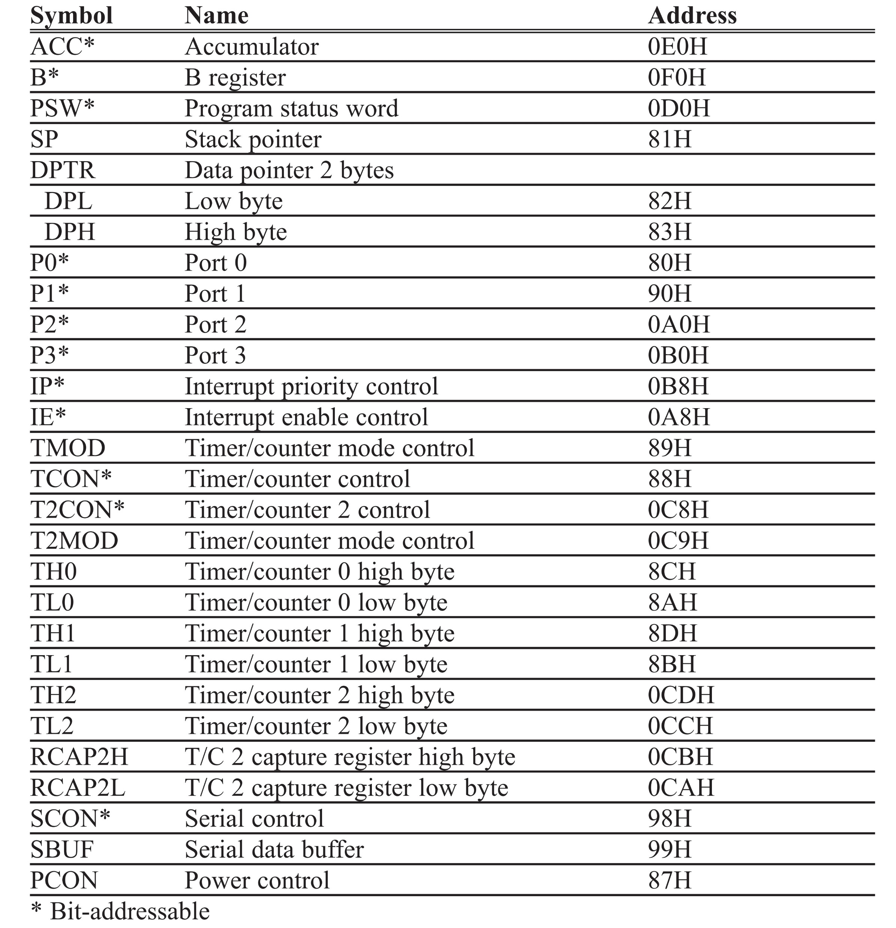
Table 5-1: 8051 Special Function Register (SFR) Addresses

Slide 6
Table 5-1: 8051 Special Function Register (SFR) Addresses

Slide 7
Example 5-1
Write code to send 55H to ports P1 and P2, using (a) their names, (b) their addresses.
Solution:
(a) MOV A,#55H ;A=55H
MOV P1,A ;P1=55H
MOV P2,A ;P2=55H
(b) From Table 5-1, P1 address = 90H; P2 address = A0H
MOV A,#55H ;A=55H
MOV 90H,A ;P1=55H
MOV 0A0H,A ;P2=55H

Slide 8
Example 5-2
Show the code to push R5, R6, and A onto the stack and then pop them back them into R2, R3, and B, where register B = register A, R2 = R6, and R3 = R5.
Solution:
PUSH 05 ;push R5 onto stack
PUSH 06 ;push R6 onto stack
PUSH 0E0H ;push register A onto stack
POP 0F0H ;pop top of stack into register B
;now register B = register A
POP 02 ;pop top of stack into R2
;now R2 = R6
POP 03 ;pop top of stack into R3
;now R3 = R5

Slide 9
Example 5-3
Write a program to copy the value 55H into RAM memory locations 40H to 45H using
(a) direct addressing mode, (b) register indirect addressing mode without a loop, and
(c) with a loop.
Solution:
(a)
MOV A,#55H ;load A with value 55H
MOV 40H,A ;copy A to RAM location 40H
MOV 41H,A ;copy A to RAM location 41H
MOV 42H,A ;copy A to RAM location 42H
MOV 43H,A ;copy A to RAM location 43H
MOV 44H,A ;copy A to RAM location 44H

Slide 10
Example 5-3
Write a program to copy the value 55H into RAM memory locations 40H to 45H using
(a) direct addressing mode, (b) register indirect addressing mode without a loop, and
(c) with a loop.
Solution:
(b) MOV A,#55H ;load A with value 55H
MOV R0,#40H ;load the pointer. R0=40H
MOV @R0,A ;copy A to RAM location R0 points to
INC R0 ;increment pointer. Now R0=41H
MOV @R0,A ;copy A to RAM location R0 points to
INC R0 ;increment pointer. Now R0=42H
MOV @R0,A ;copy A to RAM location R0 points to
INC R0 ;increment pointer. Now R0=43H
MOV @R0,A ;copy A to RAM location R0 points to
INC R0 ;increment pointer. Now R0=44H
MOV @R0,A

Slide 11
Example 5-3
Write a program to copy the value 55H into RAM memory locations 40H to 45H using
(a) direct addressing mode, (b) register indirect addressing mode without a loop, and
(c) with a loop.
Solution:
(c)
MOV A,#55 ;A=55H
MOV R0,#40H ;load pointer. R0=40H, RAM address
MOV R2,#05 ;load counter, R2=5
AGAIN: MOV @R0,A ;copy 55H to RAM location R0 points to
INC R0 ;increment R0 pointer
DJNZ R2,AGAIN ;loop until counter = zero

Slide 12
Example 5-4
Write a program to clear 16 RAM locations starting at RAM address 60H.
Solution:
CLR A ;A=0
MOV R1,#60H ;load pointer. R1=60H
MOV R7,#16 ;load counter, R7=16 (10 in hex)
AGAIN: MOV @R1,A ;clear RAM location R1 points to
INC R1 ;increment R1 pointer
DJNZ R7,AGAIN ;loop until counter = zero

Slide 13
Example 5-5
Write a program to copy a block of 10 bytes of data from RAM locations starting at 35H to RAM locations starting at 60H.
Solution:
MOV R0,#35H ;source pointer
MOV R1,#60H ;destination pointer
MOV R3,#10 ;counter
BACK: MOV A,@R0 ;get a byte from source
MOV @R1,A ;copy it to destination
INC R0 ;increment source pointer
INC R1 ;increment destination pointer
DJNZ R3,BACK ;keep doing it for all ten bytes

Slide 14
Example 5-6
Solution:
ORG 0000H ;burn into ROM starting at 0
MOV DPTR,#200H ;DPTR=200H look-up table address
CLR A ;clear A(A=0)
MOVC A,@A+DPTR ;get the char from code space MOV R0,A ;save it in R0
INC DPTR ;DPTR=201 pointing to next char
CLR A ;clear A(A=0)
MOVC A,@A+DPTR ;get the next char
MOV R1,A ;save it in R1
INC DPTR ;DPTR=202 pointing to next char
CLR A ;clear A(A=0)
MOVC A,@A+DPTR ;get the next char
MOV R2,A ;save it in R2
HERE:SJMP HERE ;stay here
;Data is burned into code space starting at 200H
ORG 200H
MYDATA: DB "USA"
END ;end of program
In this program, assume that the word “USA” is burned into ROM locations starting at 200H, and that the program is burned into ROM locations starting at 0. Analyze how the program works and state where “USA” is stored after this program is run.

Slide 15
Example 5-6
Solution:
In the above program ROM locations 200H - 202H have the following contents.
200=('U') 201=('S') 202=('A'’)
We start with DPTR = 200H, and A = 0. The instruction “MOVC A, @A+DPTR” moves the contents of ROM location 200H (200H + 0 = 200H) to register A. Register A contains 55H, the ASCII value for “U”. This is moved to R0. Next, DPTR is incremented to make DPTR = 201H. A is set to 0 again to get the contents of the next ROM location 201H, which holds character “S”. After this program is run, we have R0 = 55H, R1 = 53H, and R2 = 41H, the ASCII values for the characters “U”, “S” and “A”.
In this program, assume that the word “USA” is burned into ROM locations starting at 200H, and that the program is burned into ROM locations starting at 0. Analyze how the program works and state where “USA” is stored after this program is run.

Slide 16
Example 5-7
Assuming that ROM space starting at 250H contains “America”, write a program to transfer the bytes into RAM locations starting at 40H.
Solution:
;(a) This method uses a counter
ORG 0000
MOV DPTR,#MYDATA ;load ROM pointer
MOV R0,#40H ;load RAM pointer
MOV R2,#7 ;load counter
BACK: CLR A ;A = 0
MOVC A,@A+DPTR ;move data from code space
MOV @R0,A ;save it in RAM
INC DPTR ;increment ROM pointer
INC R0 ;increment RAM pointer
DJNZ R2,BACK ;loop until counter=0
HERE: SJMP HERE
;----------On-chip code space used for storing data
ORG 250H
MYDATA: DB "AMERICA"
END

Slide 17
Example 5-7
Assuming that ROM space starting at 250H contains “America”, write a program to transfer the bytes into RAM locations starting at 40H.
Solution:
;(b) This method uses null char for end of string
ORG 0000
MOV DPTR,#MYDATA ;load ROM pointer
MOV R0,#40H ;load RAM pointer
BACK: CLR A ;A=0
MOVC A,@A+DPTR ;move data from code space
JZ HERE ;exit if null character
MOV @R0,A ;save it in RAM
INC DPTR ;increment ROM pointer
INC R0 ;increment RAM pointer
SJMP BACK ;loop
HERE: SJMP HERE
;----------On-chip code space used for storing data
ORG 250H
MYDATA: DB "AMERICA",0 ;notice null char for
;end of string
END
Notice the null character, 0, indicating the end of the string, and how we use the JZ instruction to detect that.

Slide 18
Example 5-8
Write a program to get the x value from P1 and send x2 to P2, continuously.
Solution:
ORG 0
MOV DPTR,#300H ;load look-up table address
MOV A,#0FFH ;A=FF
MOV P1,A ;configure P1 as input port
BACK: MOV A,P1 ;get X
MOVC A,@A+DPTR ;get X squared from table
MOV P2,A ;issue it to P2
SJMP BACK ;keep doing it
ORG 300H
XSQR_TABLE:
DB 0,1,4,9,16,25,36,49,64,81
END
Notice that the first instruction could be replaced with “MOV DPTR,#XSQR_TABLE”

Slide 19
Example 5-9
Answer the following questions for Example 5-8.
(a) Indicate the content of ROM locations 300 - 309H.
(b) At what ROM location is the square of 6, and what value should be there?
(c) Assume that P1 has a value of 9: What value is at P2 (in binary)?
Solution:
(a) All values are in hex.
300 = (00) 301 = (01) 302 = (04) 303 = (09)
304 = (10) 4 x 4 = 16 = 10 in hex
305 = (19) 5 x 5 = 25 = 19 in hex
306 = (24) 6 x 6 = 36 = 24H
307 = (31) 308 = (40) 309 = (51)
(b) 306H; it is 24H
(c) 01010001B, which is 51H and 81 in decimal (9² = 81).

Slide 20
Example 5-10
Write a program to toggle P1 a total of 200 times. Use RAM location 32H to hold your counter value instead of registers R0 - R7.
Solution:
MOV P1,#55H ;P1=55H
MOV 32H,#200 ;load counter value into RAM loc 32h
LOP1: CPL P1 ;toggle P1
ACALL DELAY
DJNZ 32H,LOP1 ;repeat 200 times

Slide 21
Example 5-11
Find out to which byte each of the following bits belongs. Give the address of the RAM byte in hex.
(a) SETB 42H ;set bit 42H to 1 (d) SETB 28H ;set bit 28H to 1
(b) CLR 67H ;clear bit 67 (e) CLR 12 ;clear bit 12 (decimal)
(c) CLR 0FH ;clear bit 0FH (f) SETB 05
Solution:
(a) RAM bit address of 42H belongs to D2 of RAM location 28H.
(b) RAM bit address of 67H belongs to D7 of RAM location 2CH.
(c) RAM bit address of 0FH belongs to D7 of RAM location 21H.
(d) RAM bit address of 28H belongs to D0 of RAM location 25H.
(e) RAM bit address of 12 belongs to D4 of RAM location 21H.
(f) RAM bit address of 05 belongs to D5 of RAM location 20H.

Slide 22
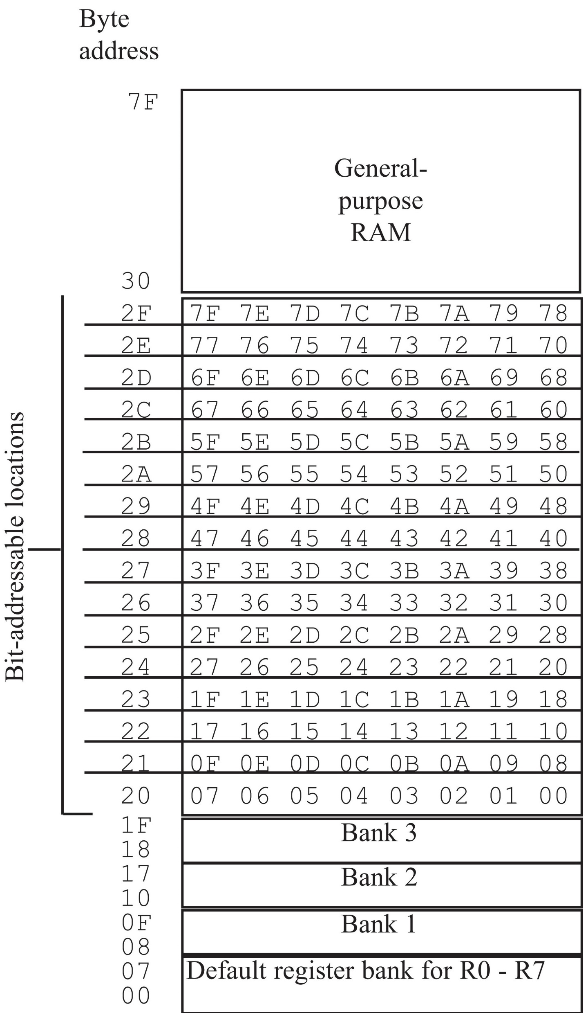
Figure 5-1. 16 Bytes of Internal RAM.
Note: They are both
bit- and byte-accessible.

Slide 23
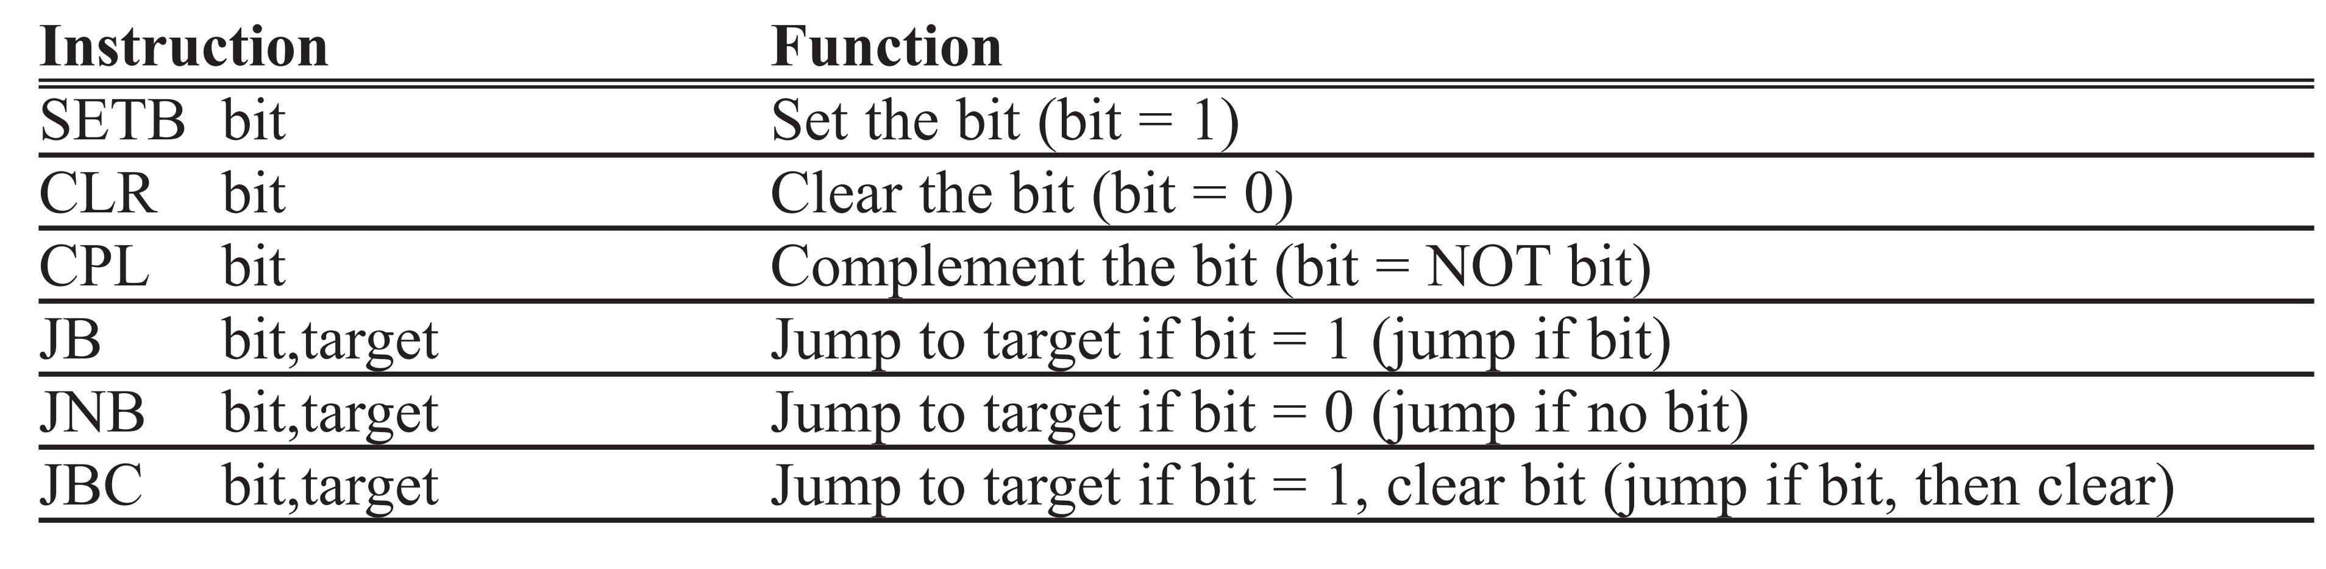
Table 5-2: Single-Bit Instructions

Slide 24
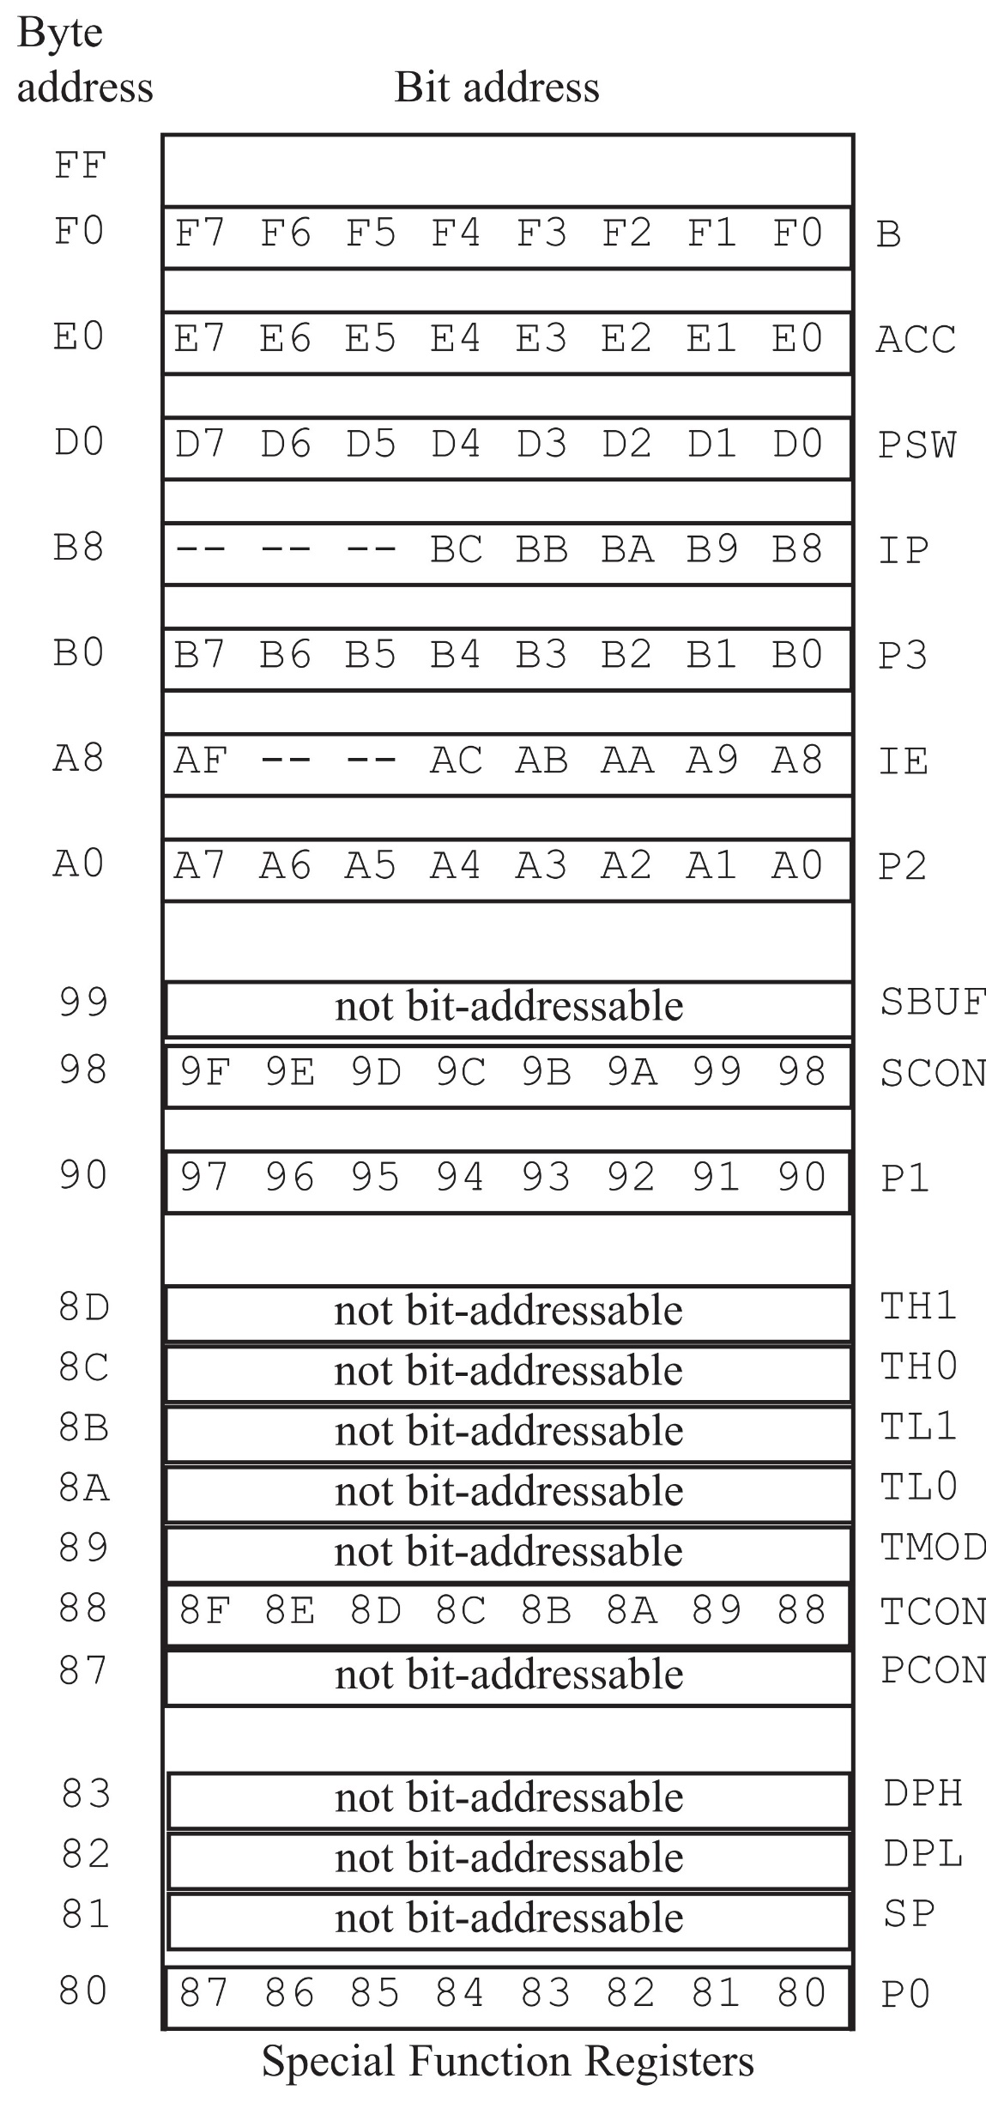
Figure 5-2. SFR RAM Address
(Byte and Bit)

Slide 25
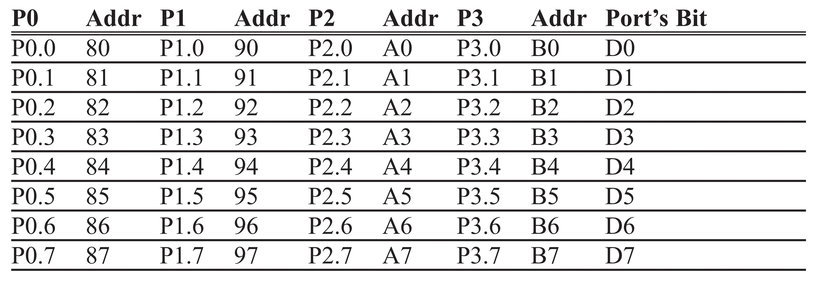
Table 5-3: Bit Addresses for All Ports

Slide 26
Example 5-12
For each of the following instructions, state to which port the bit belongs. Use Table 5-3.
(a) SETB 86H (b) CLR 87H (c) SETB 92H (d) SETB 0A7H
Solution:
(a) SETB 86H is for SETB P0.6.
(b) CLR 87H is for CLR P0.7.
(c) SETB 92H is for SETB P1.2.
(d) SETB 0A7H is for SETB P2.7.

Slide 27
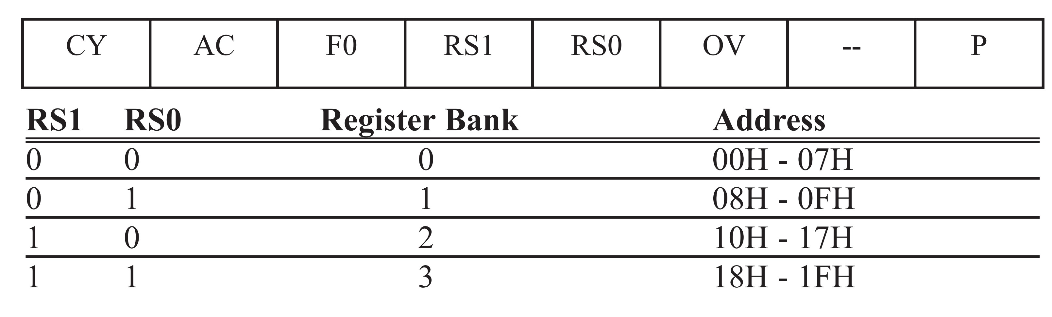
Figure 5-3. Bits of the PSW Register

Slide 28
Example 5-13
Write a program to save the Accumulator in R7 of bank 2.
Solution:
CLR PSW.3
SETB PSW.4
MOV R7,A

Slide 29
Example 5-14
While there are instructions such as JNC and JC to check the carry flag bit (CY), there are no such instructions for the overflow flag bit (OV). How would you write code to check OV?
Solution:
The OV flag is PSW.2 of the PSW register. PSW is a bit-addressable register; therefore, we can use the following instruction to check the OV flag.
JB PSW.2,TARGET ;jump if OV=1

Slide 30
Example 5-15
Write a program to see if the RAM location 37H contains an even value. If so, send it to P2. If not, make it even and then send it to P2.
Solution:
MOV A,37H ;load RAM location 37H into accumulator
JNB ACC.0,YES ;is D0 of reg A 0? if so jump
INC A ;it is odd, make it even
YES: MOV P2,A ;send it to P2

Slide 31
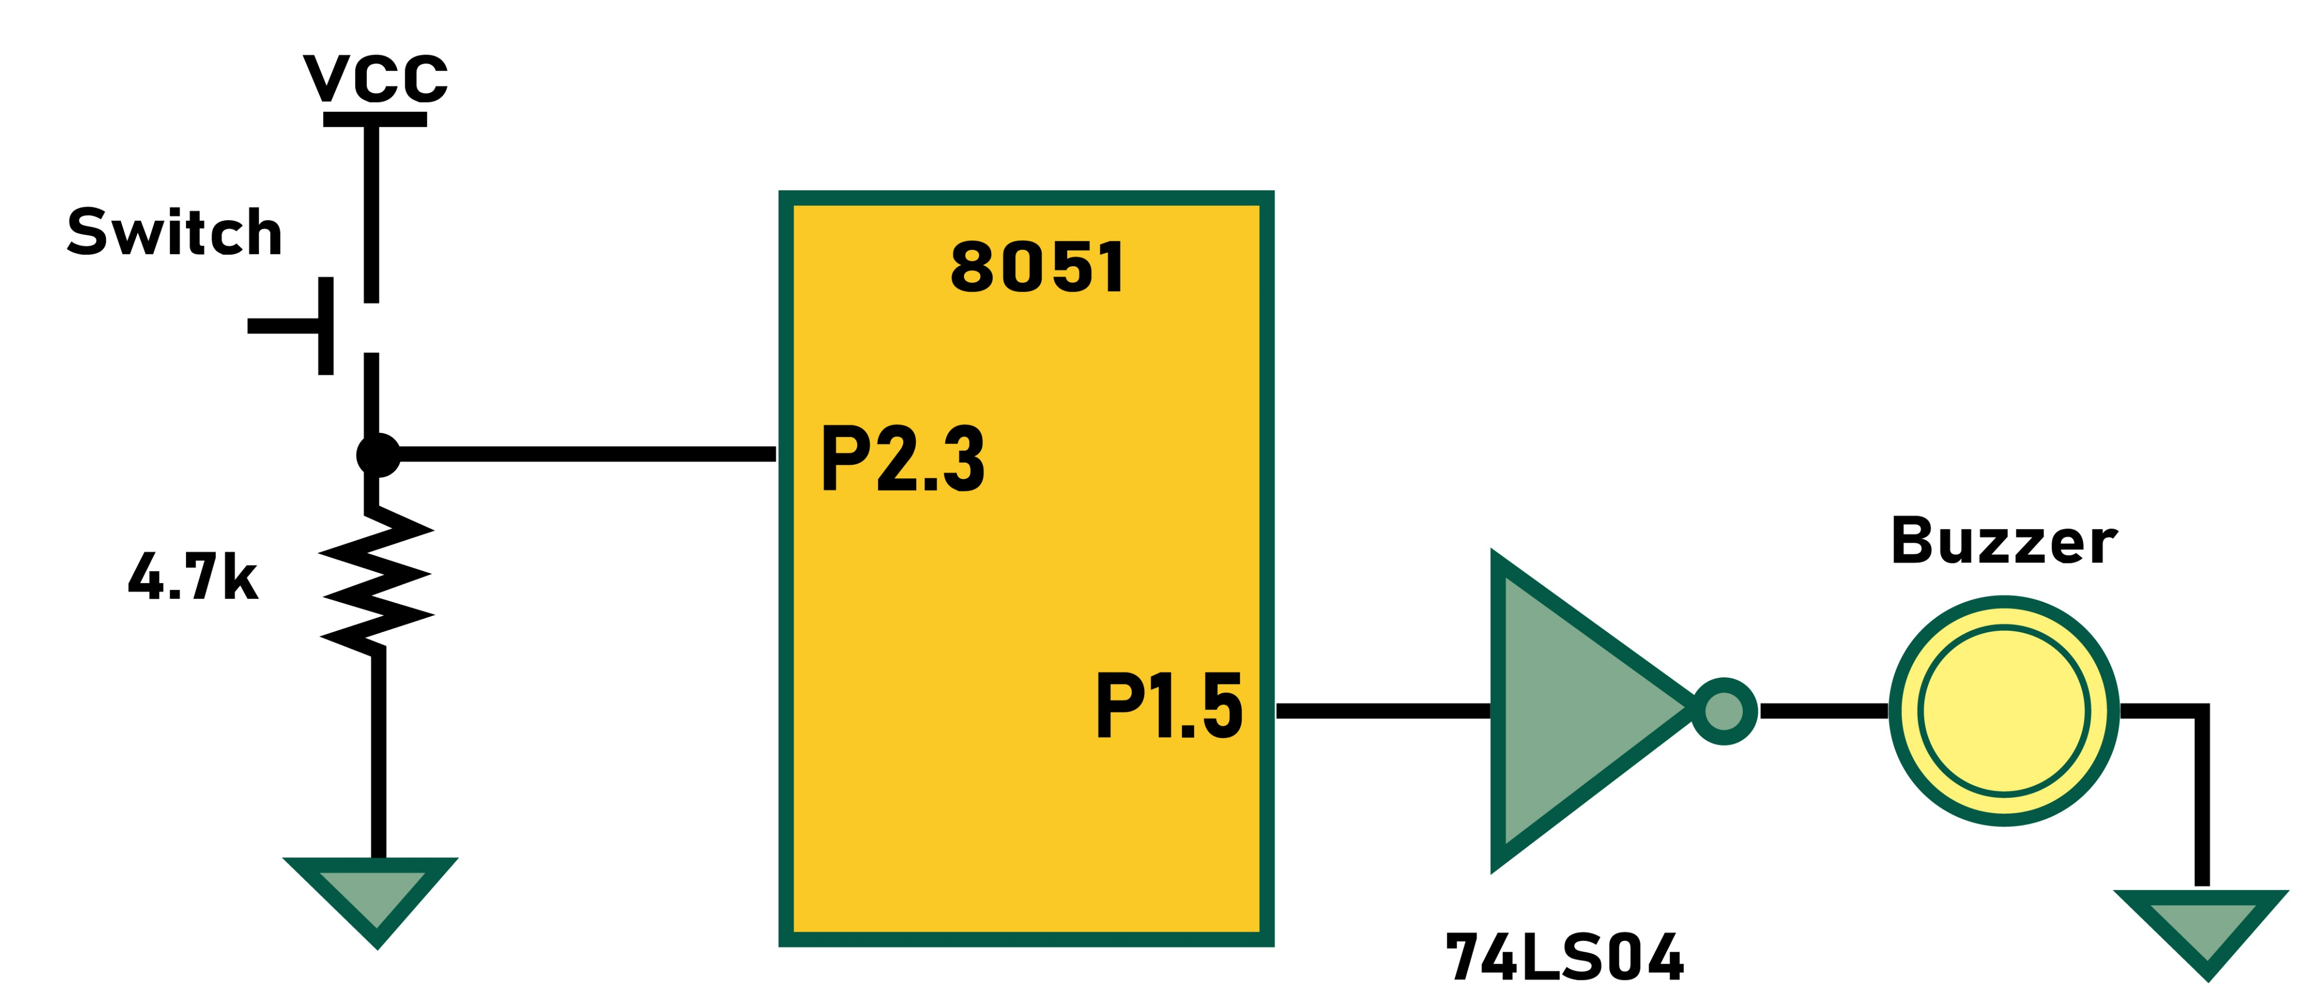
Example 5-16
Assume that bit P2.3 is an input and represents the condition of a door. If it goes high, it means that the door is open. Monitor the bit continuously. Whenever it goes high, send a low-to-high pulse to port P1.5 to turn on a buzzer.
Solution:
HERE: JNB P2.3,HERE ;keep monitoring for high
CLR P1.5 ;Clear bit (P1.5 = 0)
ACALL DELAY
SETB P1.5 ;P1.5=1 (low-to-high pulse)
ACALL DELAY
SJMP HERE

Slide 32
Example 5-17
The status of bits P1.2 and P1.3 of I/O port P1 must be saved before they are changed. Write a program to save the status of P1.2 in bit location 06 and the status of P1.3 in bit location 07.
Solution:
CLR 06 ;clear bit address 06
CLR 07 ;clear bit address 07
JNB P1.2,OVER ;check bit P1.2,if 0 then jump
SETB 06 ;if P1.2=1,set bit location 06 to 1
OVER:JNB P1.3,NEXT ;check bit P1.3, if 0 then jump
SETB 07 ;if P1.3=1, set bit location 07 to 1
NEXT:...

Slide 33
Example 5-18
Write a program to save the status of bit P1.7 on RAM address bit 05.
Solution:
MOV C,P1.7 ;get bit from port
MOV 05,C ;save bit

Slide 34
Example 5-19
Write a program to get the status of bit pin P1.7 and send it to pin P2.0.
Solution:
HERE: MOV C,P1.7 ;get bit from port
MOV P2.0,C ;send bit to port
SJMP HERE ;repeat forever

Slide 35
Example 5-20
Assume that bit P2.3 is an input and represents the condition of an oven. If it goes high, it means that the oven is hot. Monitor the bit continuously. Whenever it goes high, send a low-to-high pulse to port P1.5 to turn on a buzzer.
Solution:
OVEN_HOT BIT P2.3
BUZZER BIT P1.5
HERE:JNB OVEN_HOT,HERE ;keep monitoring for HOT
ACALL DELAY ;
CPL BUZZER ;sound the buzzer
ACALL DELAY ;
SJMP HERE
This is similar to Example 5-16, except the use of BIT directive allows us to assign the OVEN_HOT and BUZZER bit to any port. This way you do not have to search the program for them.

Slide 36
Example 5-21
An LED is connected to pin P1.7. Write a program to toggle the LED forever.
Solution:
LED BIT P.7 ;using BIT directive
HERE: CPL LED ;toggle LED
LCALL DELAY ;delay
SJMP HERE ;repeat forever

Slide 37
Example 5-22
A switch is connected to pin P1.7 and an LED to pin P2.0. Write a program to get the status of the switch and send it to the LED.
Solution:
SW BIT P1.7 ;assign bit
LED BIT P2.0 ;assign bit
HERE: MOV C,SW ;get the bit from the port
MOV LED,C ;send the bit to the port
SJMP HERE ;repeat forever

Slide 38
Example 5-23
Assume that RAM bit location 12H holds the status of whether there has been a phone call or not. If it is high, it means there has been a new call since it was checked the last time. Write a program to display “New Messages” on an LCD if bit RAM 12H is high. If it is low, the LCD should say “No New Messages”.
Solution:
PHONBIT BIT 12H
MOV C,PHONBIT ;copy bit location 12H to carry
JNC NO ;check to see if is high
MOV DPTR,#400H ;yes, load address of message
LCALL DISPLAY ;display message (see Chap. 12)
SJMP EXIT ;get out
NO: MOV DPTR,#420H ;load the address of No message
LCALL DISPLAY ;display it
EXIT: ;exit
;—————————————data to be displayed on LCD
ORG 400H
YES_MG: DB "New Messages",0
ORG 420H
NO_MG: DB "No New Messages",0

Slide 39
Example 5-24
A switch is connected to pin P1.7. Write a program to check the status of the switch and make the following decision.
(a) If SW = 0, send “NO” to P2. (b) If SW = 1, send “YES” to P2.
Solution:
SW EQU P1.7
MYDATA EQU P2
HERE: MOV C,SW
JC OVER
MOV MYDATA,#'N’ ;SW=0, send "NO"
MOV MYDATA,#'O'
SJMP HERE
OVER: MOV MYDATA,#'Y’’ ;SW=1, send "YES"
MOV MYDATA,#'E'
MOV MYDATA,#'S'
SJMP HERE
END

Slide 40
Example 5-25
switch is connected to pin P1.7. Write a program to check the status of the switch and make the following decision.
(a) If SW = 0, send ‘0’ to P2. (b) If SW = 1, send ‘1’ to P2.
Use EQU to designate the I/O ports.
Solution:
SW EQU 97H ;P1.7 bit address
MYDATA EQU 0A0H ;P2 address
HERE: MOV C,SW
JC OVER
MOV MYDATA,#'0' ;00110000 to P2
SJMP HERE
OVER: MOV MYDATA,#'1’ ;00110001 to P2
SJMP HERE
END

Slide 41
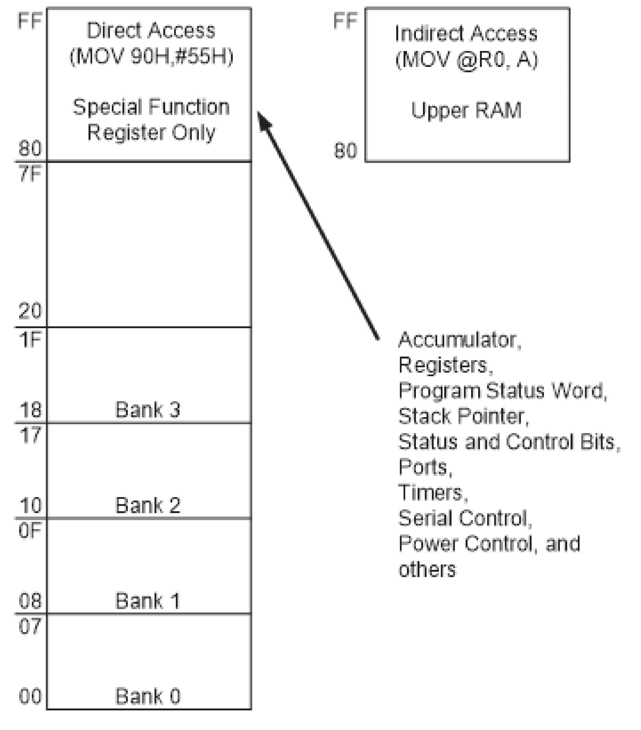
Figure 5-4. 8052 On-Chip RAM Address Space

Slide 42
Example 5-26
Write a program for the 8052 to put 55H into the upper RAM locations of 90 - 99H.
Solution:
ORG 0
MOV A,#55H
MOV R2,#10
MOV R0,#90H ;access the upper 128 bytes of on-chip RAM
BACK:MOV @R0,A ;use indirect addressing mode
INC R0
DJNZ R2,BACK ;repeat for all locations
SJMP $ ;stay here
END
Run the above program on your simulator and examine the upper memory to see the result. (See Figures 5-5 and 5-6 for screen shots.)

Slide 43
Example 5-27
Assume that the on-chip ROM has a message. Write a program to copy it from code space into the upper memory space starting at address 80H. Also, as you place a byte in upper RAM, give a copy to P0.
Solution:
ORG 0
MOV DPTR,#MYDATA
MOV R1,#80H ;access the upper 128 bytes of on-chip RAM
B1: CLR A
MOVC A,@A+DPTR ;copy from code ROM space
MOV @R1,A ;store in upper RAM space
MOV P0,A ;give a copy to P0
JZ EXIT ;exit if last byte
INC DPTR ;increment DPTR
INC R1 ;increment R1
SJMP B1 ;repeat until the last byte
EXIT: SJMP $ ;stay here when finished
;-----------
ORG 300H
MYDATA: DB "The Promise of World Peace",0
END

Slide 44
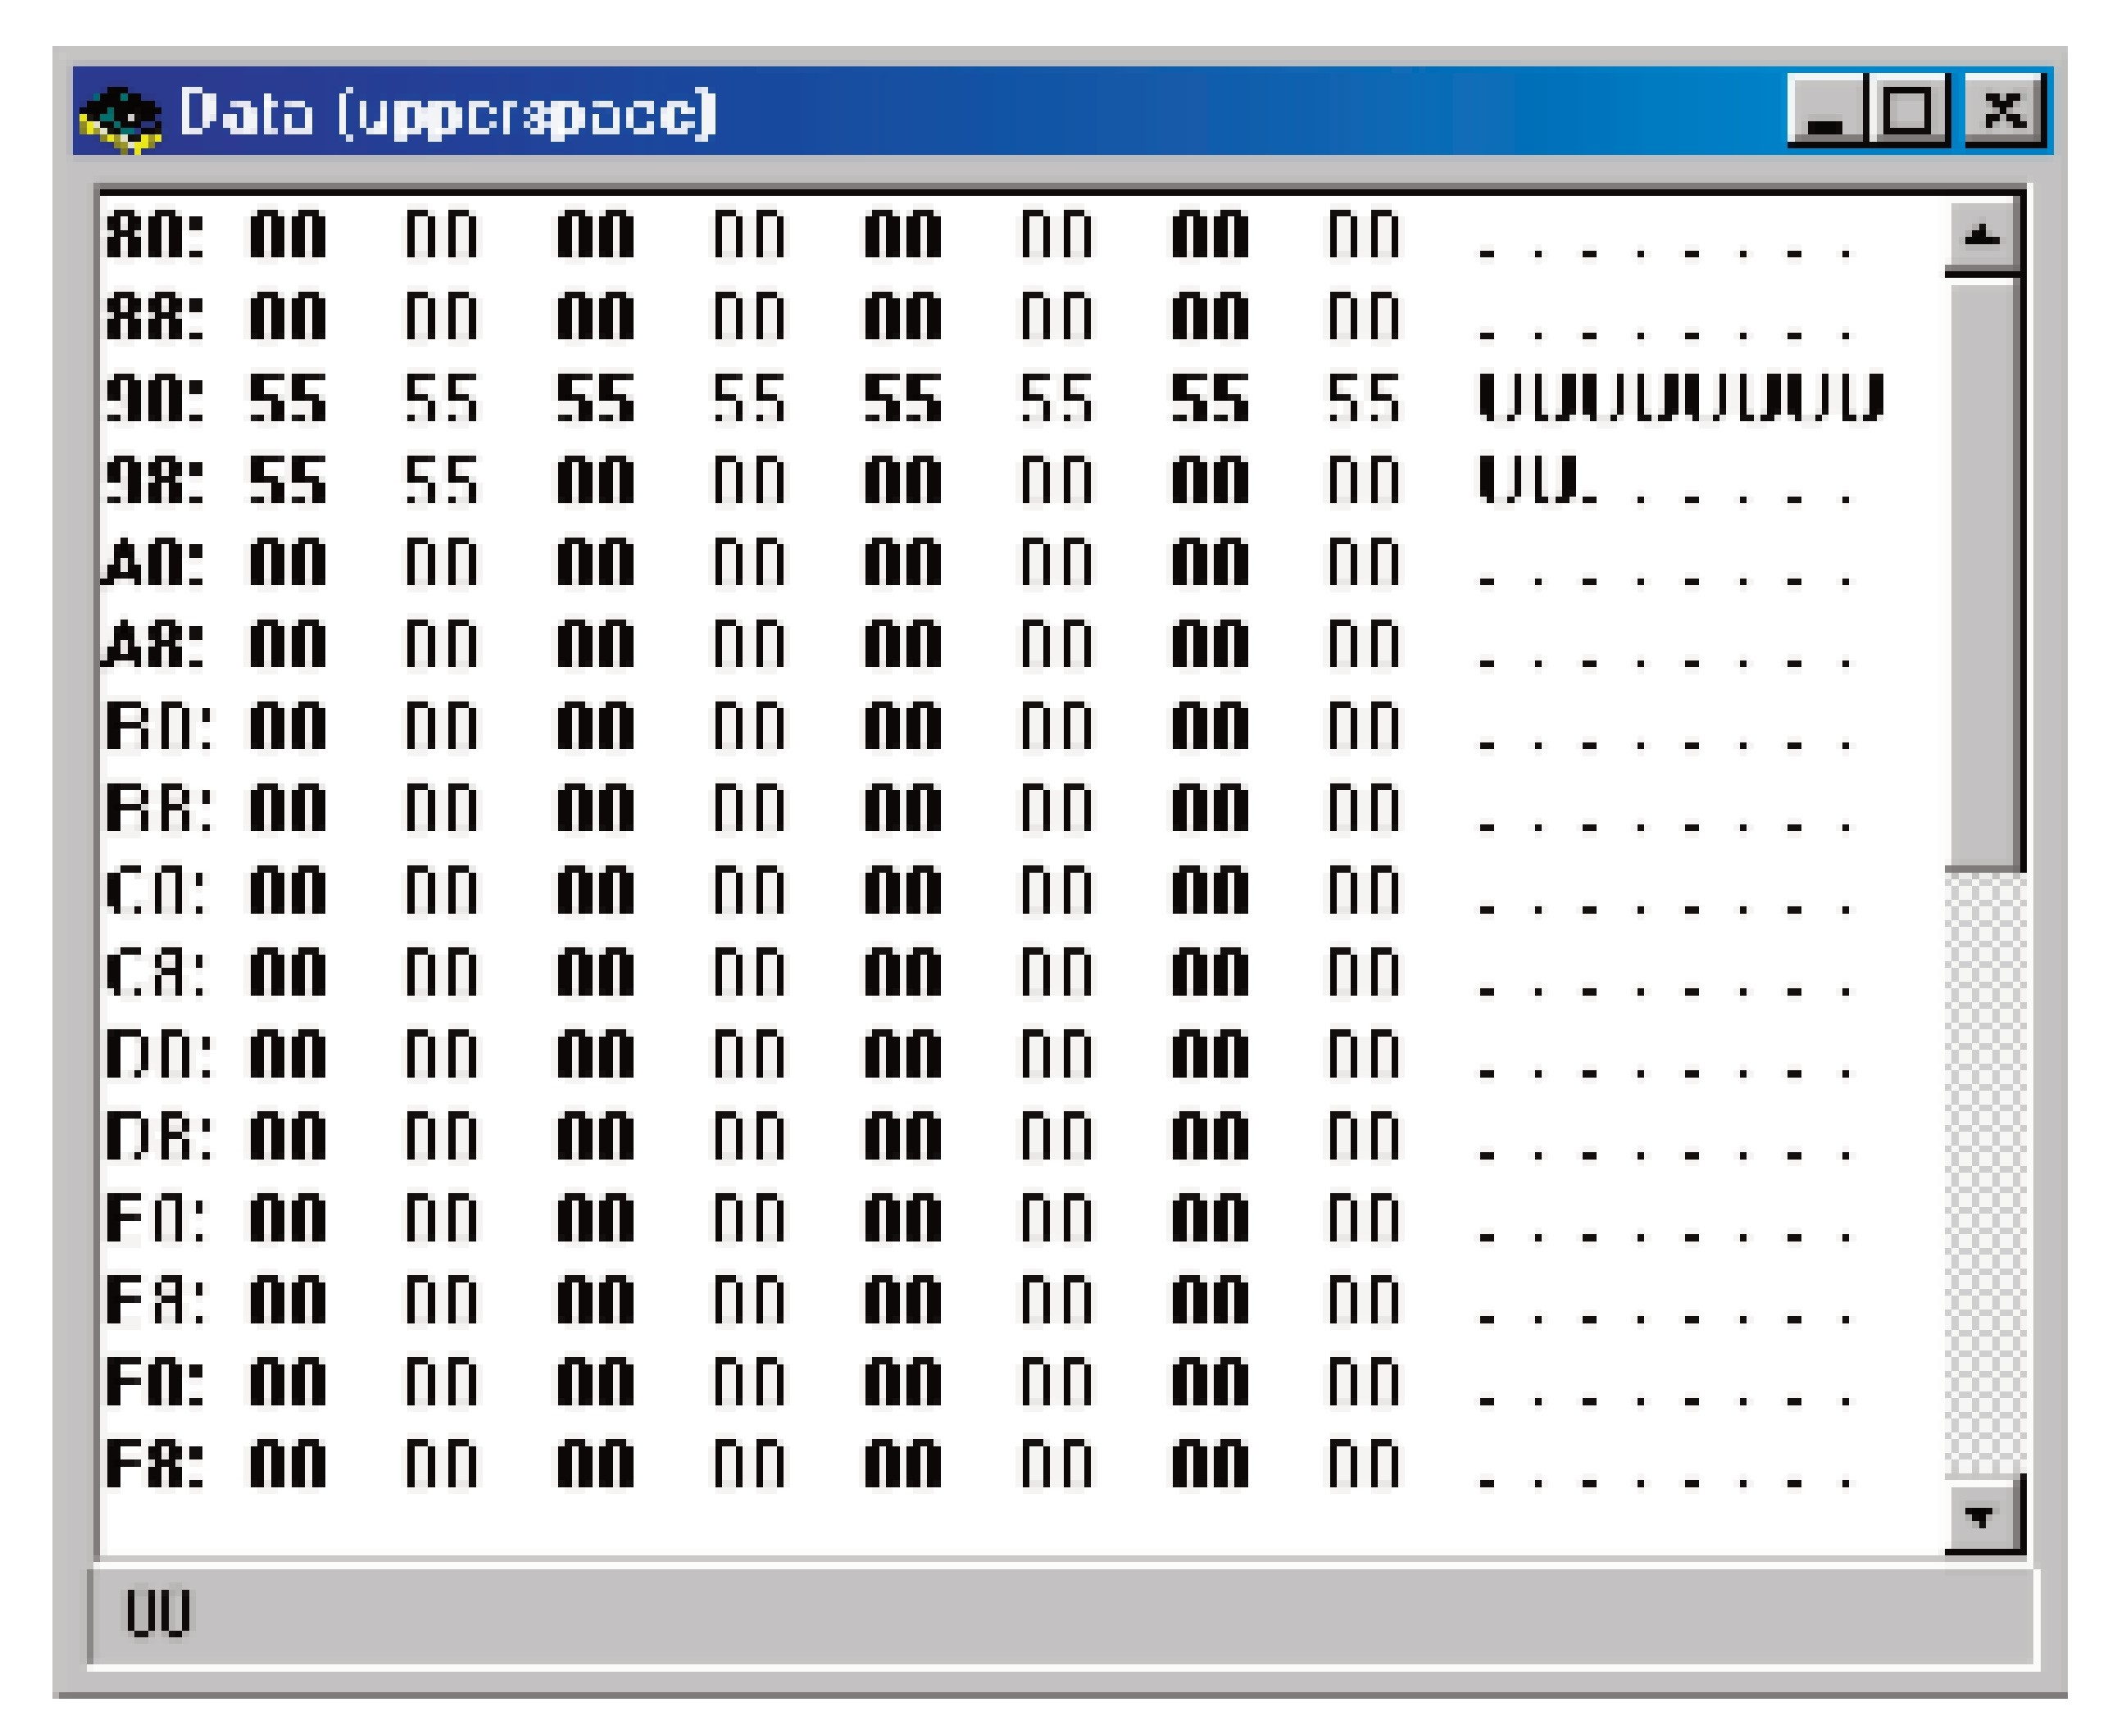
Figure 5-5. Franklin Software’s ProView Upper Memory for the 8052

Slide 45
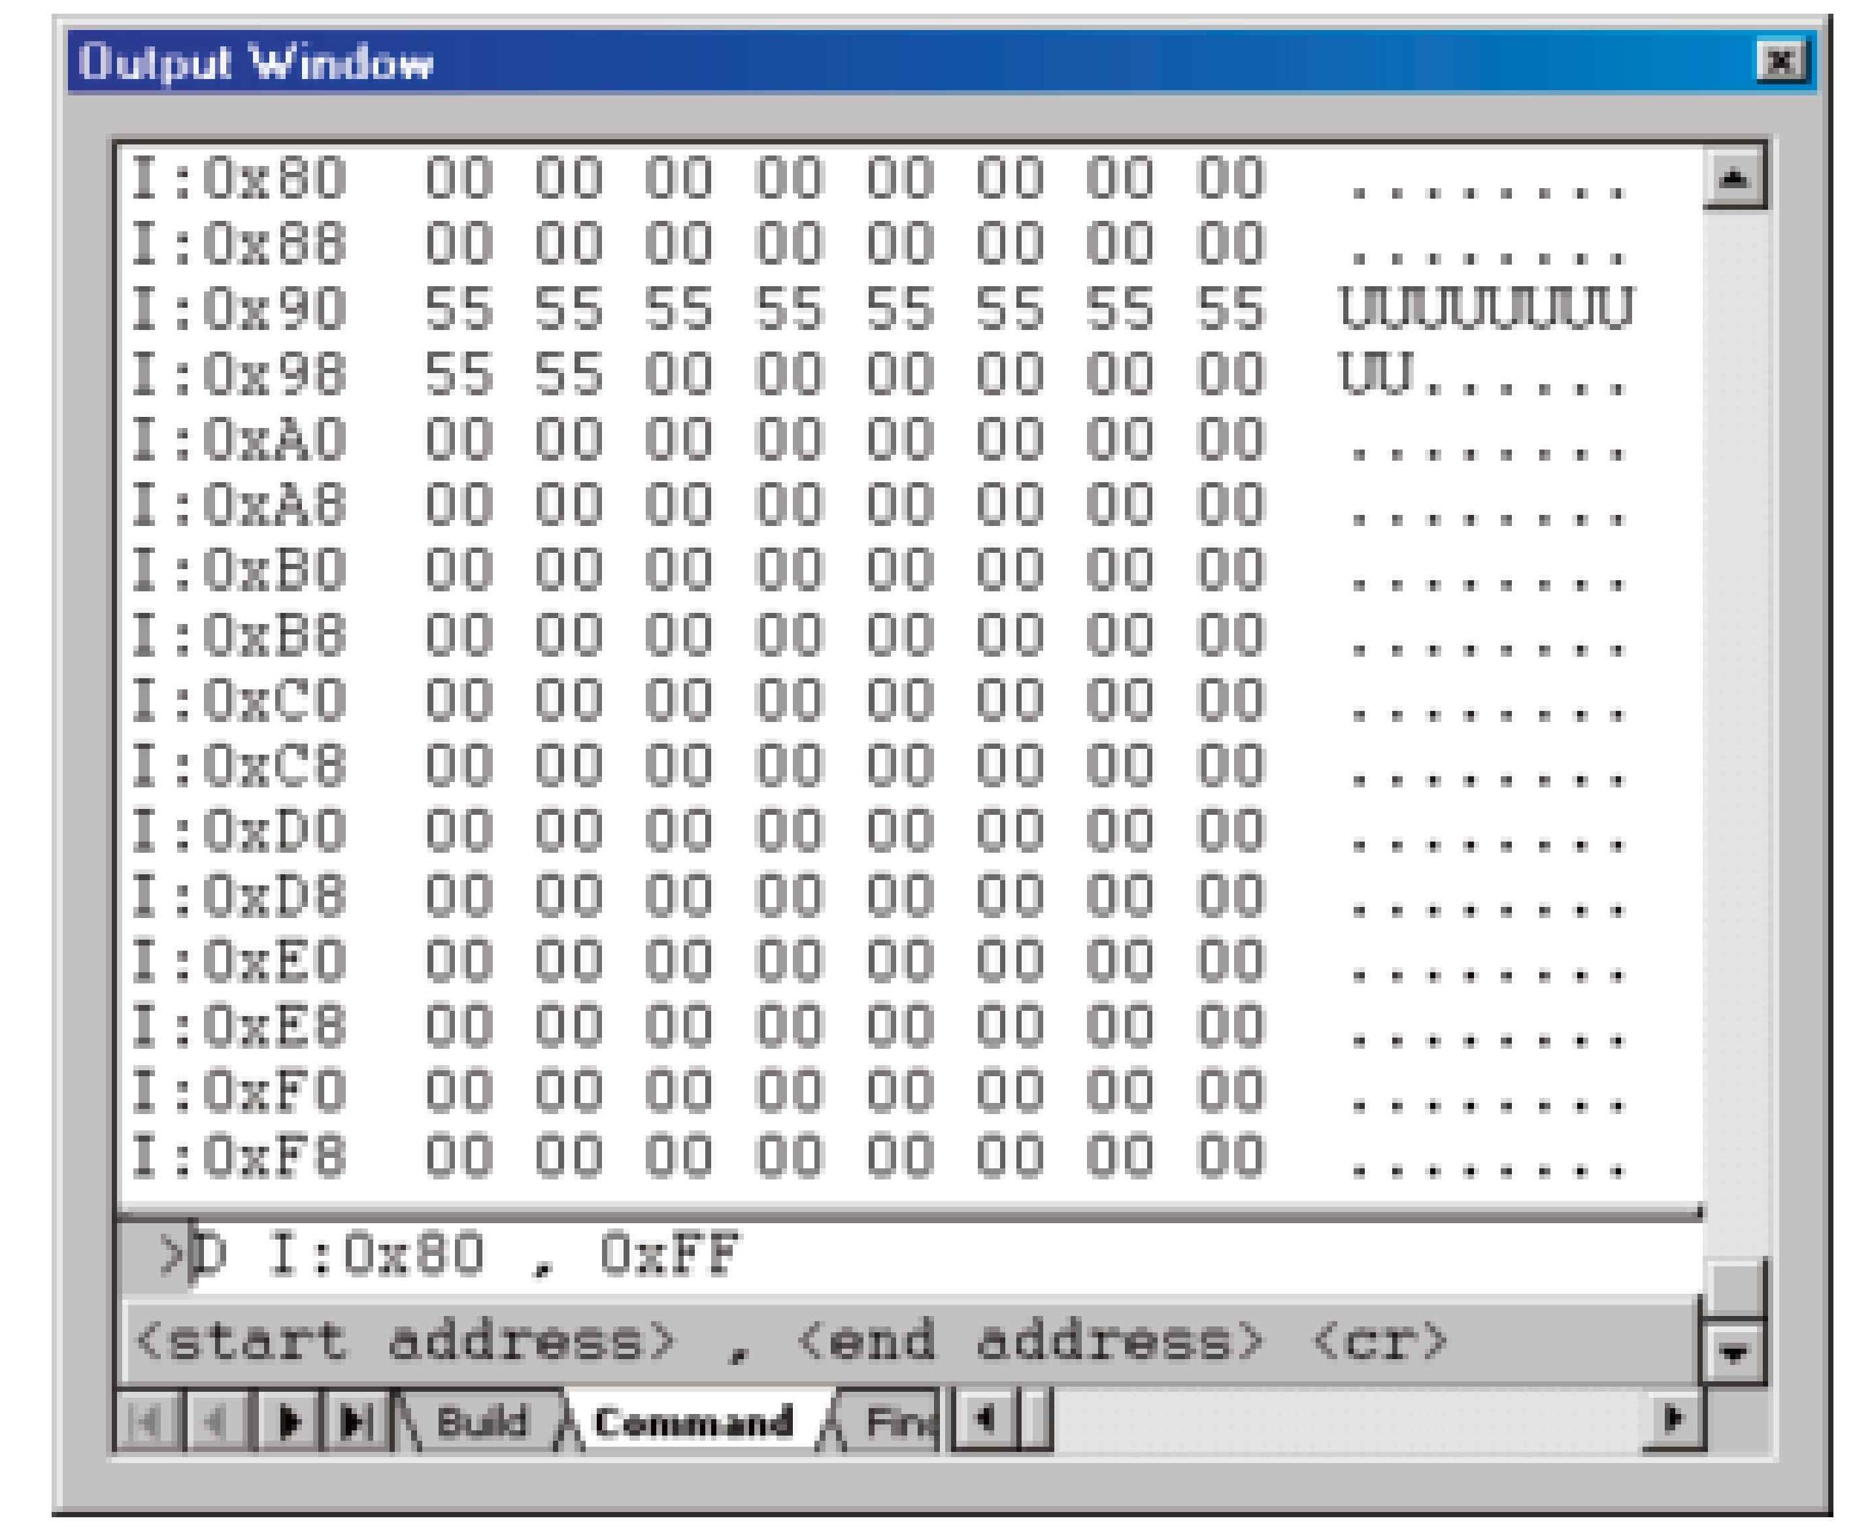
Figure 5-6. Keil’s µVision Upper Memory for the 8052

